Slide 1
Generative Adversarial Networks (GANs)

Slide 2
GANs
Generative
Generates samples instead of discriminates
Models p(x) instead of p(y|x)
Adversarial
Trained in an “Adversarial” setting (more on this to come)
Networks
Using a neural network

Slide 3
GANs Overview
Implicit data generation – create samples without any explicit data
If we have some mechanism of evaluating the quality of implicitly generated data, then we can compute a gradient for training a network
The big idea of GANs is we train two networks simultaneously –
The generator network generates real looking samples
The discriminator network tries to figure out whether or not a sample from came from the generator network or a training set
The generator network tries to fool the discriminator

Slide 4
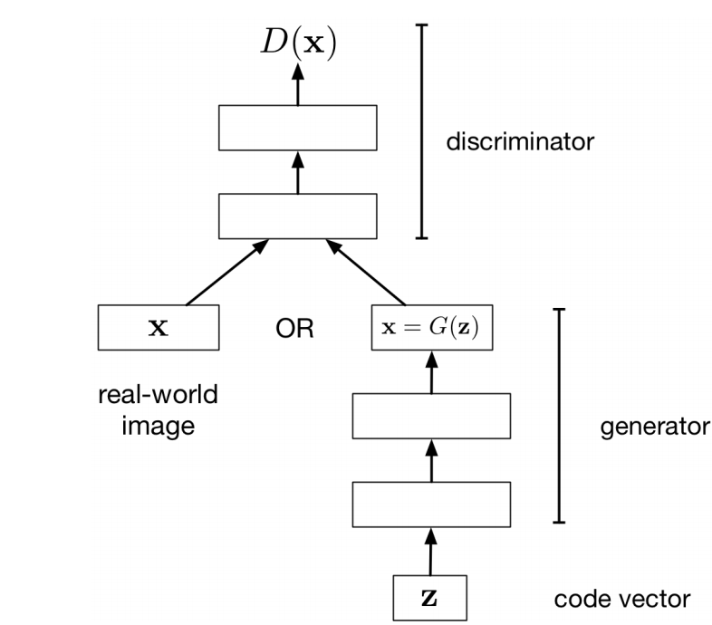
Adversarial Training

Slide 5
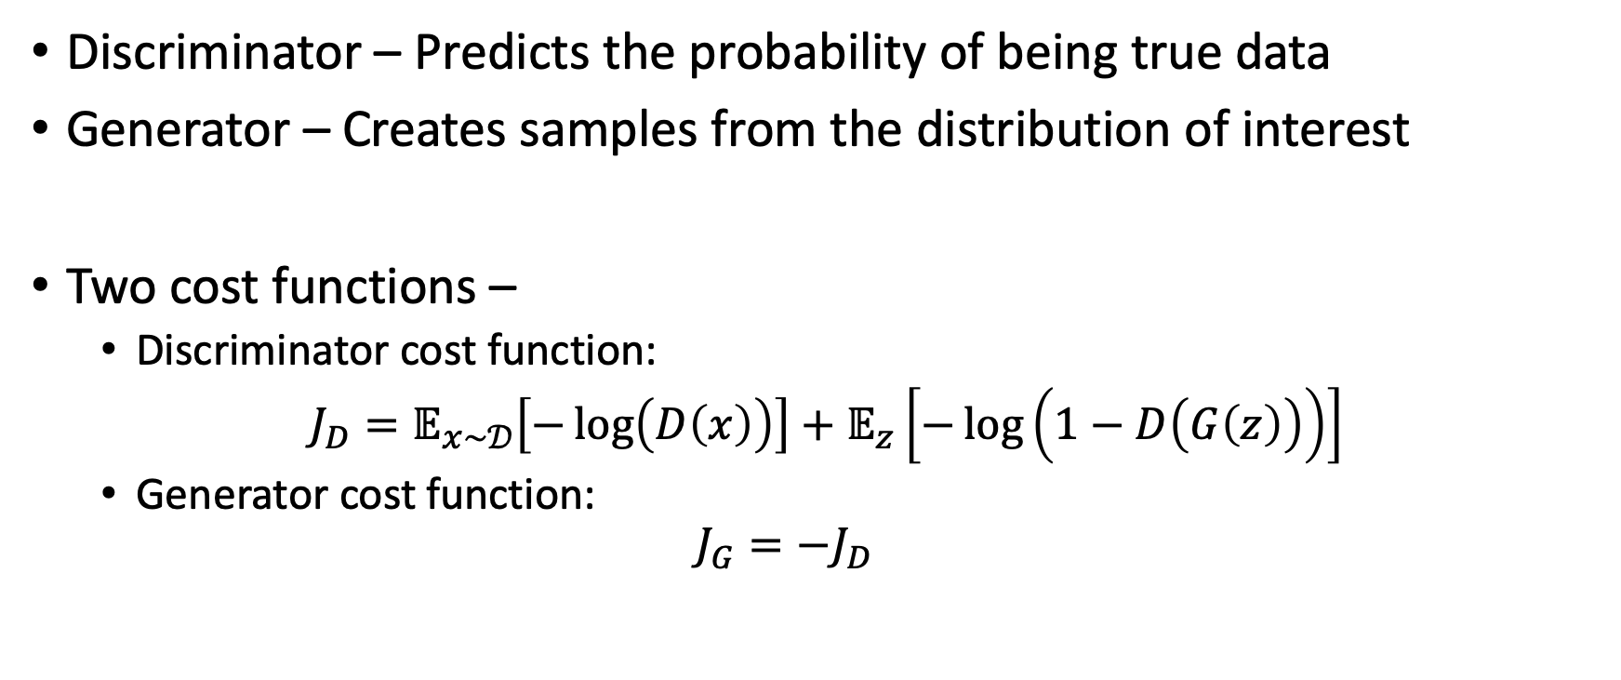
GAN Training
Discriminator – Predicts the probability of being true data
Generator – Creates samples from the distribution of interest
Two cost functions –
Discriminator cost function:
$J_{D}=𝔼_{x\sim 𝒟}\left[−\log\left(D\left(x\right)\right)\right]+$ $𝔼_{z}\left[−\log\left(1−D\left(G\left(z\right)\right)\right)\right]$
Generator cost function:
$$J_{G}=−J_{D}$$

Slide 6
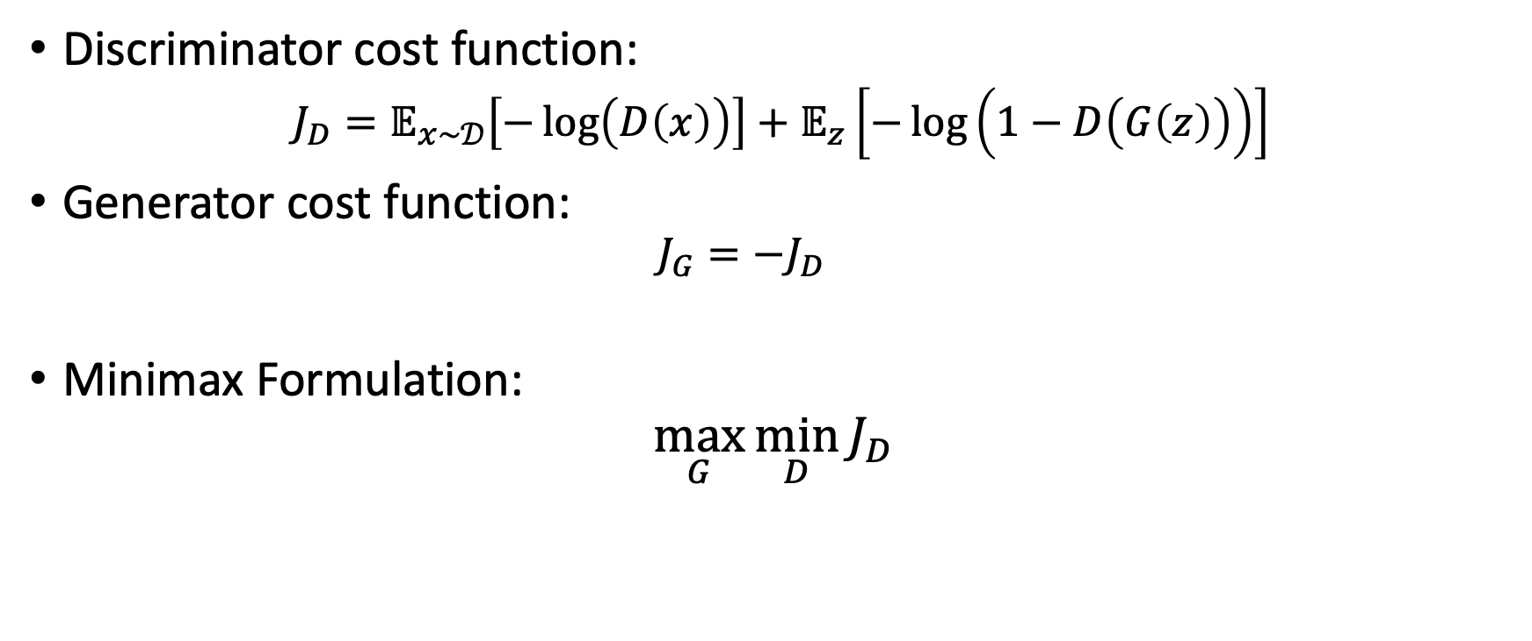
Minimax Formulation of GAN Training
Discriminator cost function:
$J_{D}=𝔼_{x\sim 𝒟}\left[−\log\left(D\left(x\right)\right)\right]+$ $𝔼_{z}\left[−\log\left(1−D\left(G\left(z\right)\right)\right)\right]$
Generator cost function:
$$J_{G}=−J_{D}$$
Minimax Formulation:
$$\max_{G}{\min_{D}{J_{D}}}$$

Slide 7
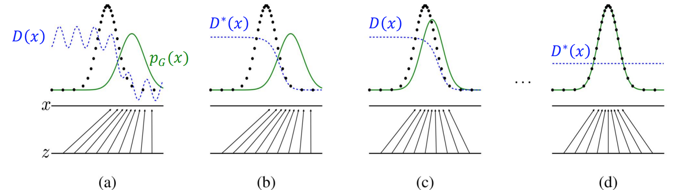
Training the GAN

Slide 8
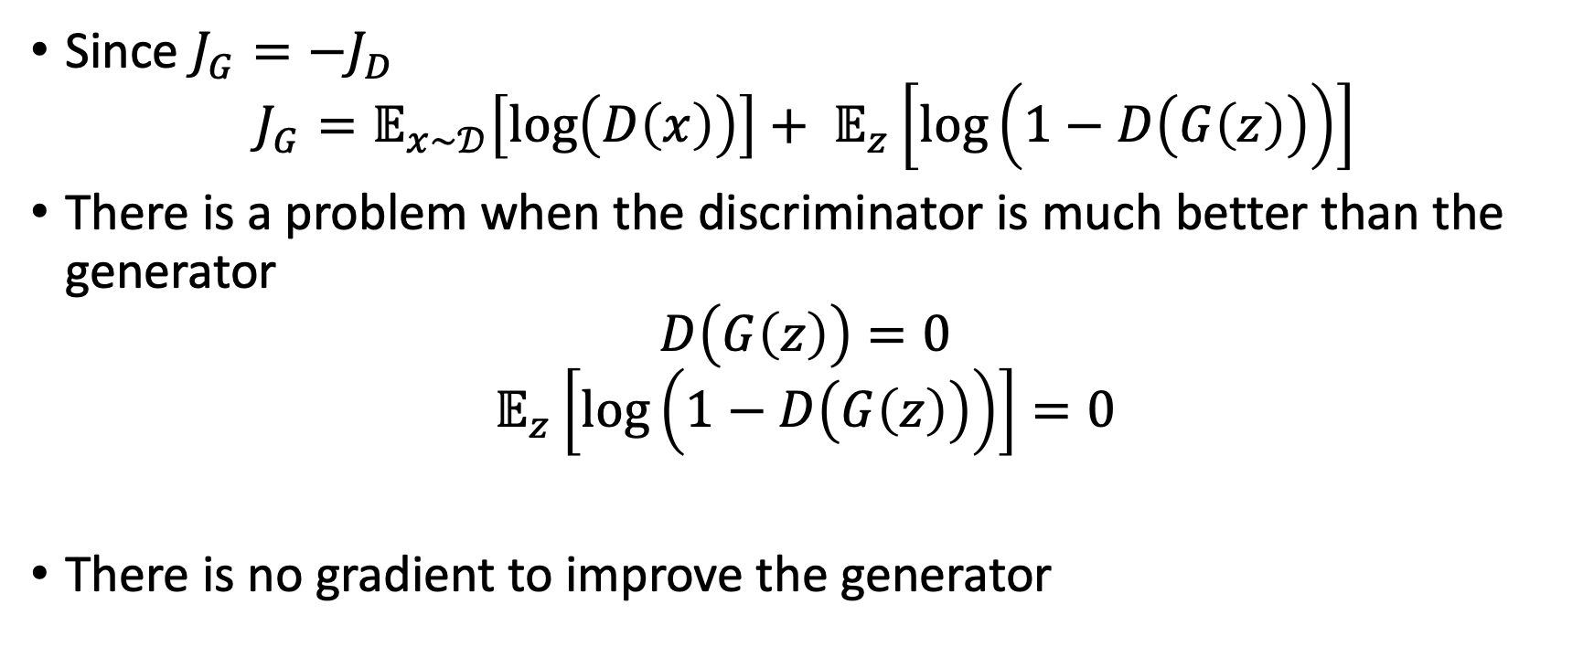
Problem with the Minimax Formulation
Since $J_{G}=−J_{D}$
$$J_{G}=𝔼_{x\sim 𝒟}\left[\log\left(D\left(x\right)\right)\right]+ 𝔼_{z}\left[\log\left(1−D\left(G\left(z\right)\right)\right)\right]$$
There is a problem when the discriminator is much better than the generator
$$D\left(G\left(z\right)\right)=0$$
$$𝔼_{z}\left[\log\left(1−D\left(G\left(z\right)\right)\right)\right]=0$$
There is no gradient to improve the generator

Slide 9
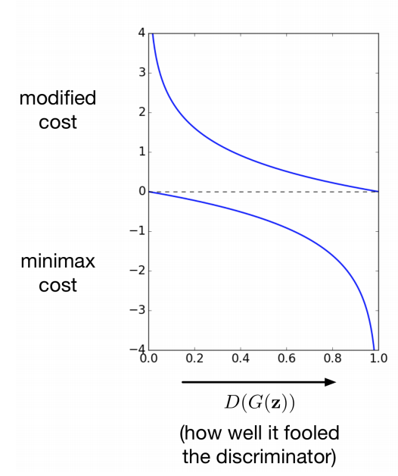
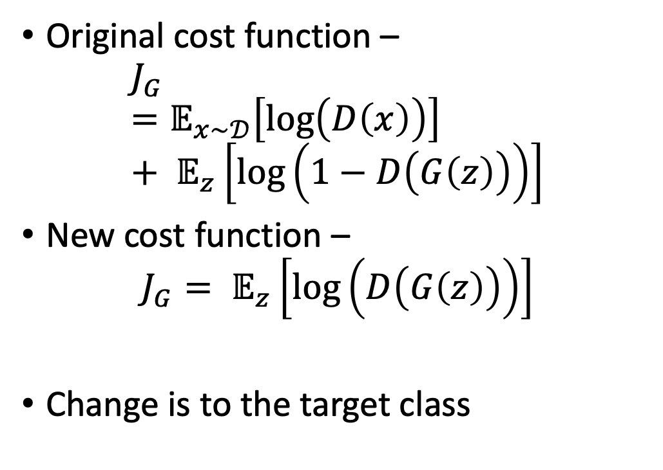
A Better Cost Function
Original cost function –
$$J_{G}=𝔼_{x\sim 𝒟}\left[\log\left(D\left(x\right)\right)\right]+ 𝔼_{z}\left[\log\left(1−D\left(G\left(z\right)\right)\right)\right]$$
New cost function –
$$J_{G}= 𝔼_{z}\left[\log\left(D\left(G\left(z\right)\right)\right)\right]$$
Change is to the target class

Slide 10
GANs
Since their original formulation in 2014, hundreds of papers have introduced various training techniques and architectures
Many common architectures focus on image generation and rely on the DC-GAN architecture
De-Convolution Generative Adversarial Network
Generator and Discriminator are convolutional neural networks

Slide 11
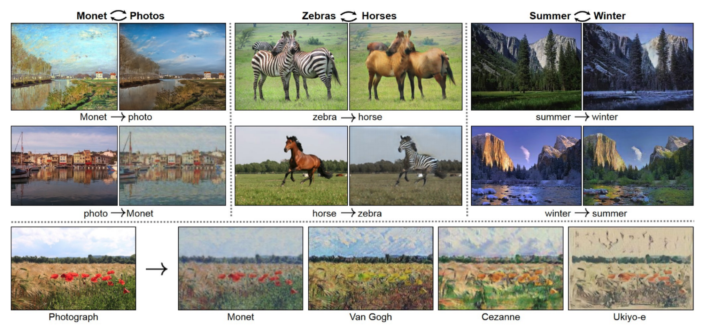
CycleGAN
Style Transfer: Change the style of an image while preserving its content
Data: Two unrelated collections of images, one set for each style

Slide 12
CycleGANs
If we have paired data, this just becomes a supervised learning problem
Often times, it is hard or impossible to find paired data
The CycleGAN architecture learns style transfer from unpaired data
Train two different generator networks to go from style 1 to style 2 and vice versa
Make sure the generated samples of style 2 are indistinguishable from real images in the generator set
Make sure the generators are cycle consistent – mapping from style 1 to style 2 and back should give you back almost the original image

Slide 13
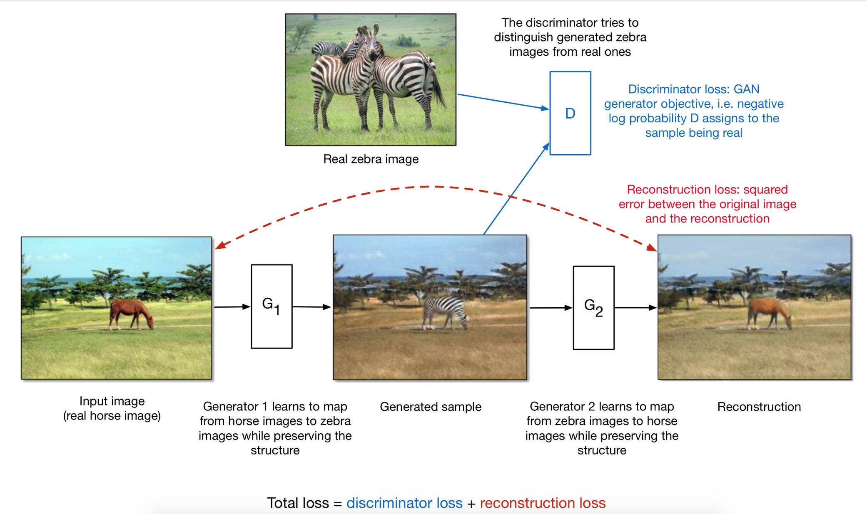

Slide 14
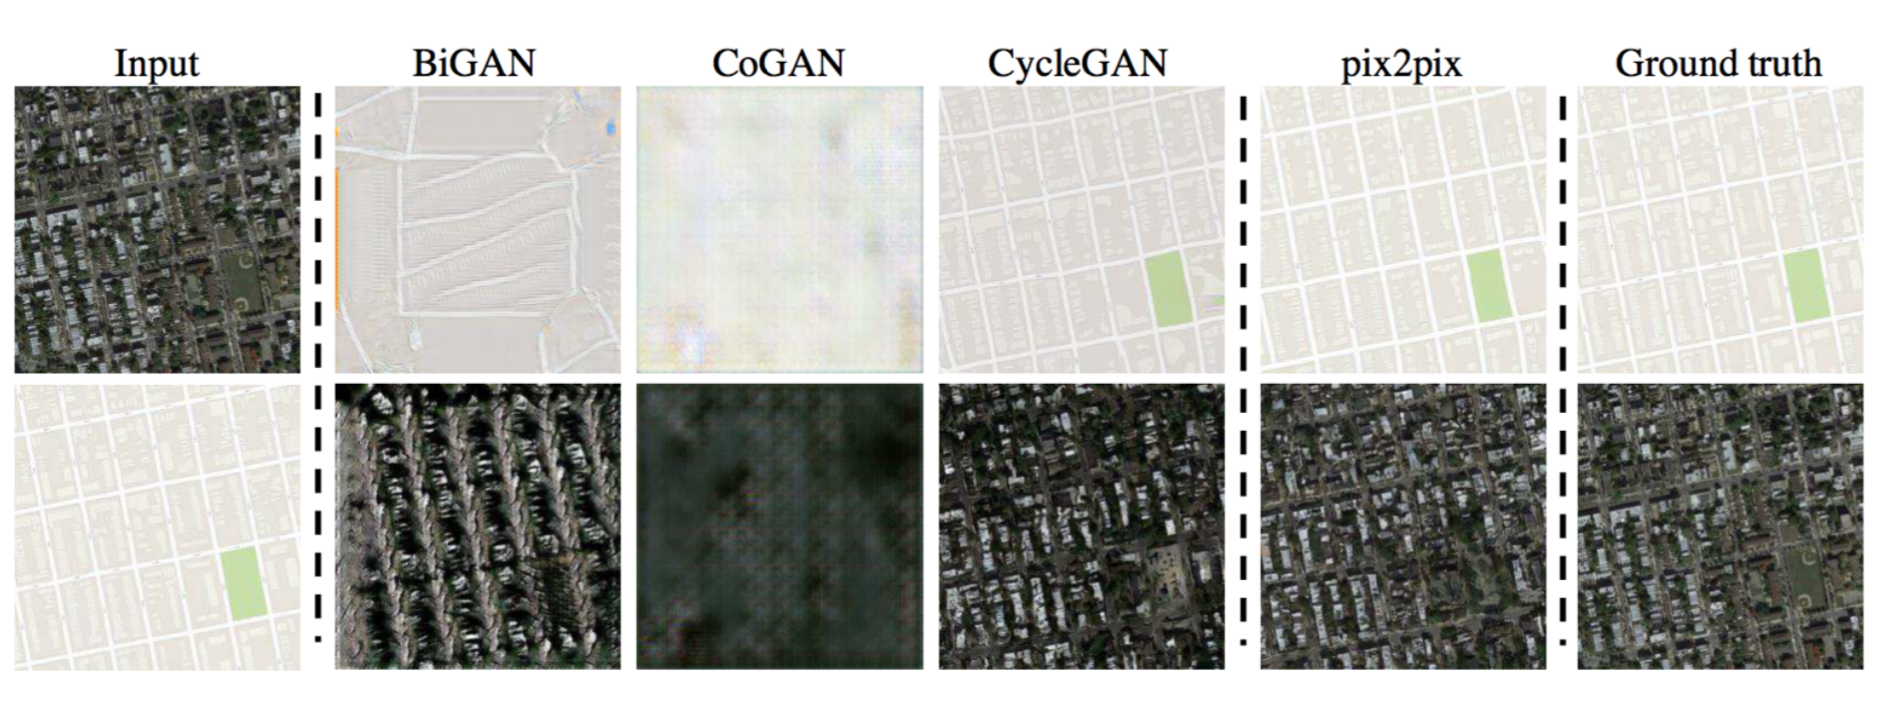
CycleGAN – Style Transfer Between Photos and Maps

